Slide 1

THE GREATER EARTH MOVEMENT

Slide 2

AGENDA
CURRENT SITUATION (GLOBAL)
CORNERSTONES OF THE CURRENT ECONOMIC SYSTEM
MOVEMENT AIMS (GLOBAL TIME OUT)
RESOURCE BASED ECONOMY
THE NEW SYSTEM

Slide 3
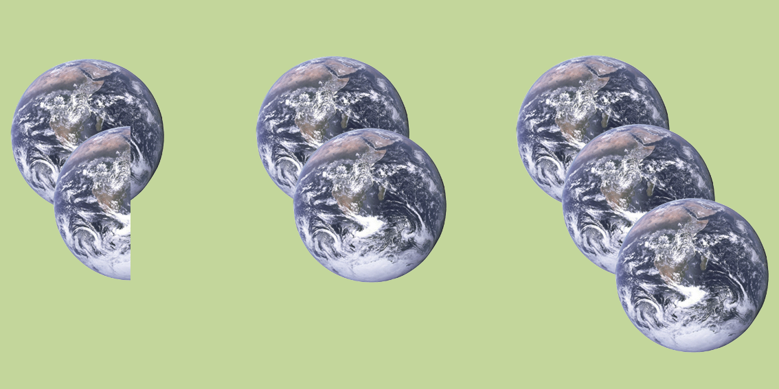
CURRENT SITUATION
2010
2030
2050

Slide 4
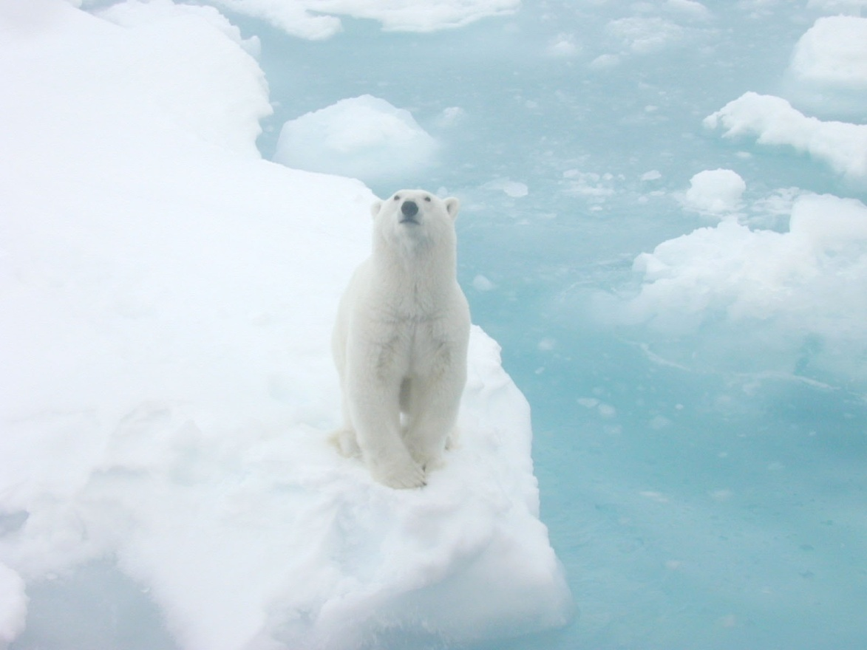
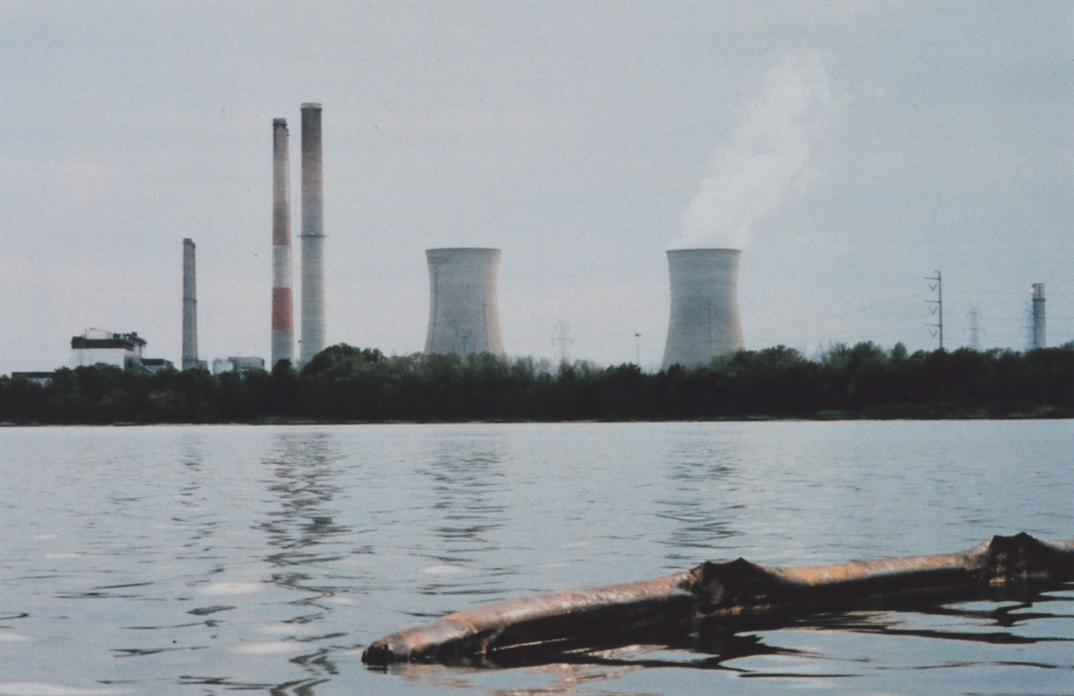
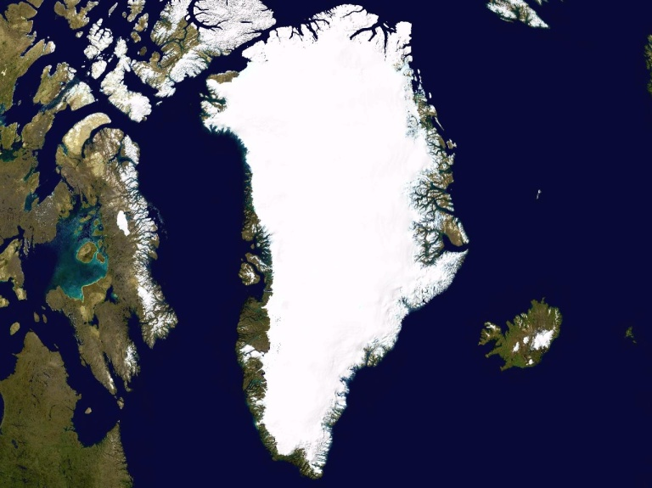
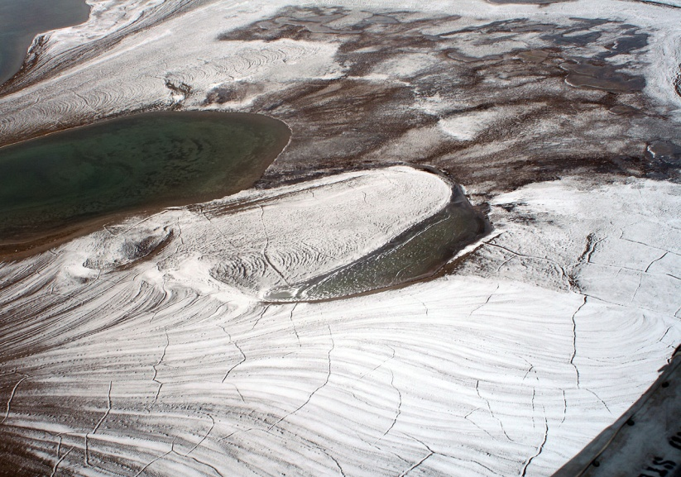
CURRENT SITUATION
800 000 years
Ice-free summer 2030
CH4
C
+ 7m
3 years

Slide 5

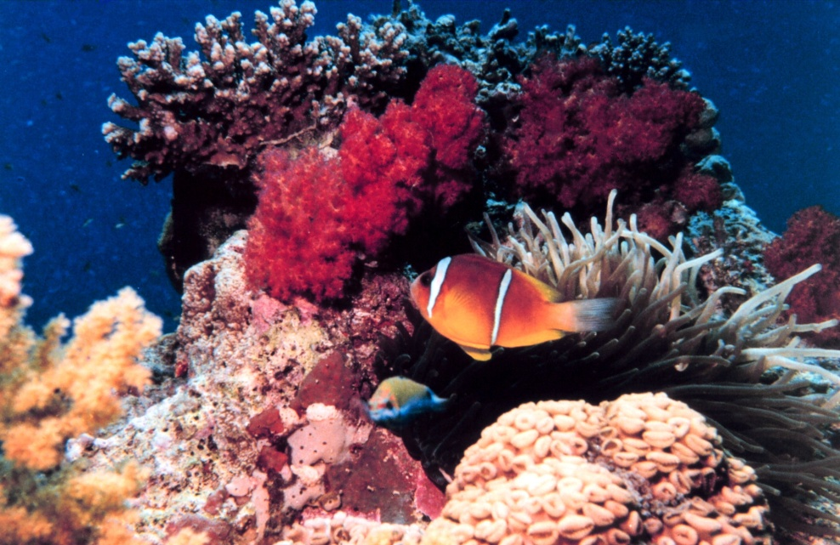
CURRENT SITUATION
90%
2050: Collapse
10%
2033: 60% gone
PRIMARY THREAT: ACIDIFICATION

Slide 6
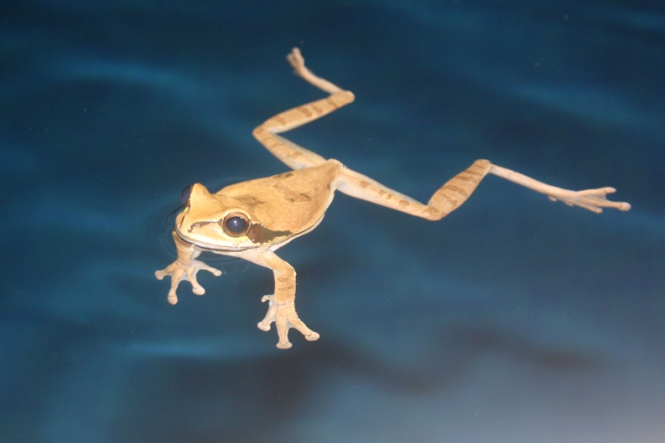
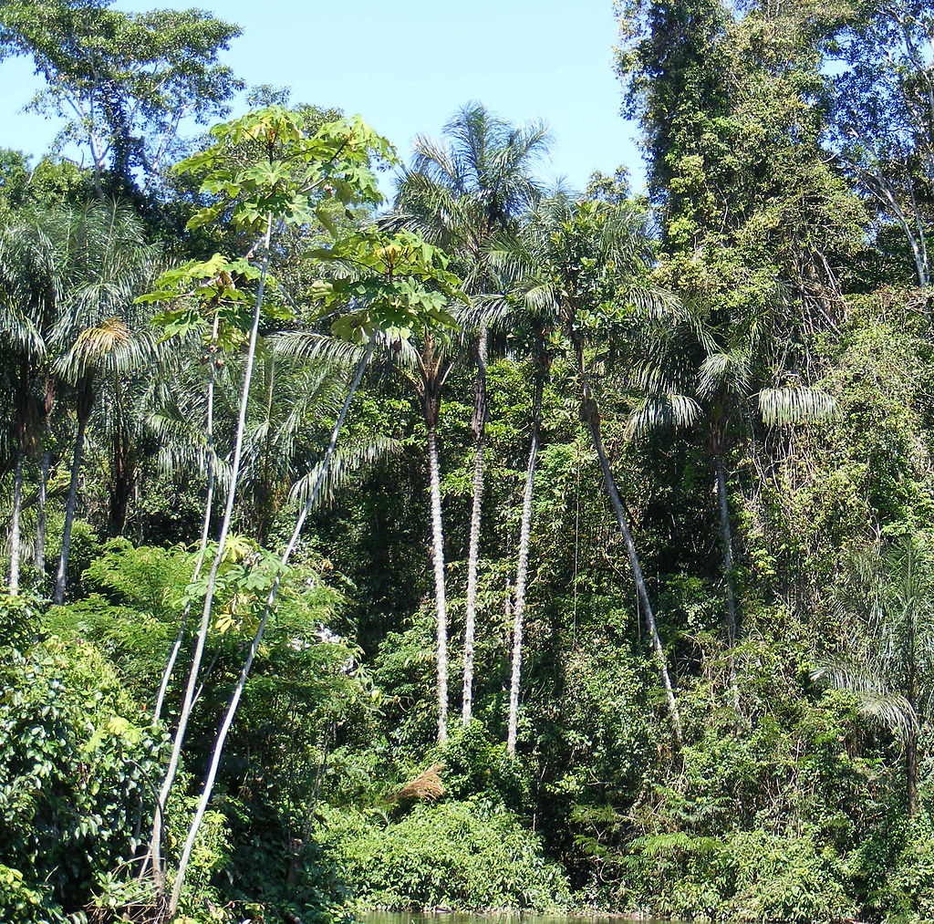
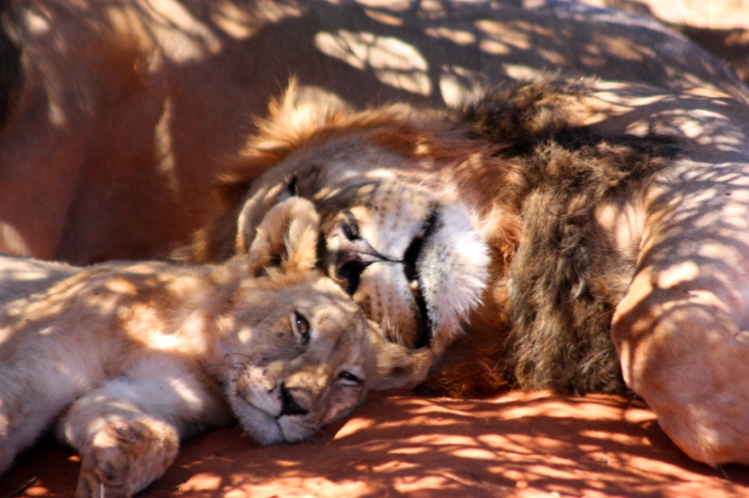
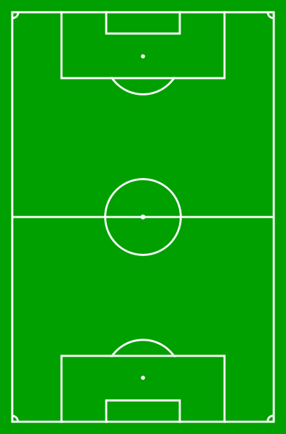
CURRENT SITUATION
1/3
70%
x 36/min
1/5
Gone 2030?

Slide 7
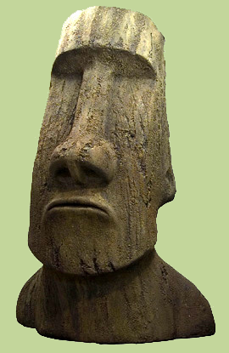
CURRENT SITUATION
PETRI DISH
”EASTER ISLAND”
ALTERNATIVES

Slide 8


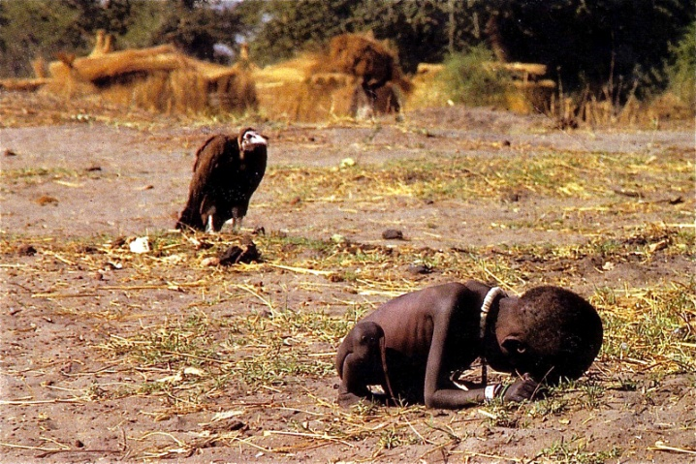
CURRENT SITUATION
62
3 500 000 000
6 000 000 / year

Slide 9

THREE CORNERSTONES
V
WORLD BANK
(WB)
INTERNATIONAL
MONETARY FUND
(IMF)
WORLD TRADE
ORGANIZATION
(WTO)

Slide 10
MODUS OPERANDI
WB/IMF
MONOPOLY
LOANS
DEBT
INTEREST
WTO
RULES
PATENTS

Slide 11

EFFECTS
Egoism
”Profitable” wars
- A depleted third world
Rich elites and starving people
Increasing wealth gaps
Consumer society

Slide 12
MOVEMENT AIMS
GLOBAL TIME OUT
Ban wars.
2. Nullify international debt and remove the
interest based economy.
Limit personal wealth and distribute assets among
the entire population of the earth and create a
system based on a Resource Based Economy.
Limit the population of mankind to a level able to
be sustained on the earth together with a rich
bio-diversity of other organisms.

Slide 13
MOVEMENT AIMS
5. Criminalize monopoly of physical assets,
technology and information which, if kept
egoistically, will cause the loss of lives or health.
Minimize activities that are harmful to the
eco-system of the earth even though this limits
economic growth.
Prioritize technological progress to that which is
necessary to achieve a sustainable life in balance
with the world around us.
8. Establish equal rights for all humans.*

Slide 14


RESOURCE BASED ECONOMY
METHOD: SCIENTIFIC/SOCIO-ECONOMIC
LEVEL: GLOBAL
1. LOCATE AND VALUATE
SUSTAINABILITY
Jacque Fresco
Photo: Roxanne Meadows
2. MONITOR RESOURCES/
NEEDS
EFFICIENCY
3. DISTRIBUTE

Slide 15
THE NEW SYSTEM
GUIDANCE GROUP EARTH
COUNCIL OF SCIENTISTS
MINISTRY OF INFORMATION COORDINATION AND ORDER
MINISTRY OF RESOURCE MANAGEMENT
MINISTRY OF SCIENCE
JUDICIAL COUNCIL
MINISTRY OF LAW
GLOBAL DATABASE
MINISTRY OF JUSTICE

Slide 16

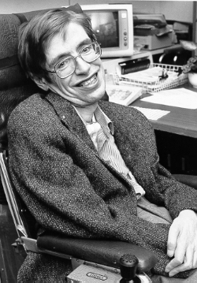
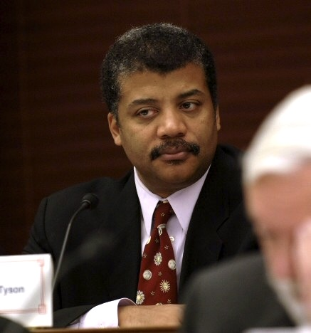
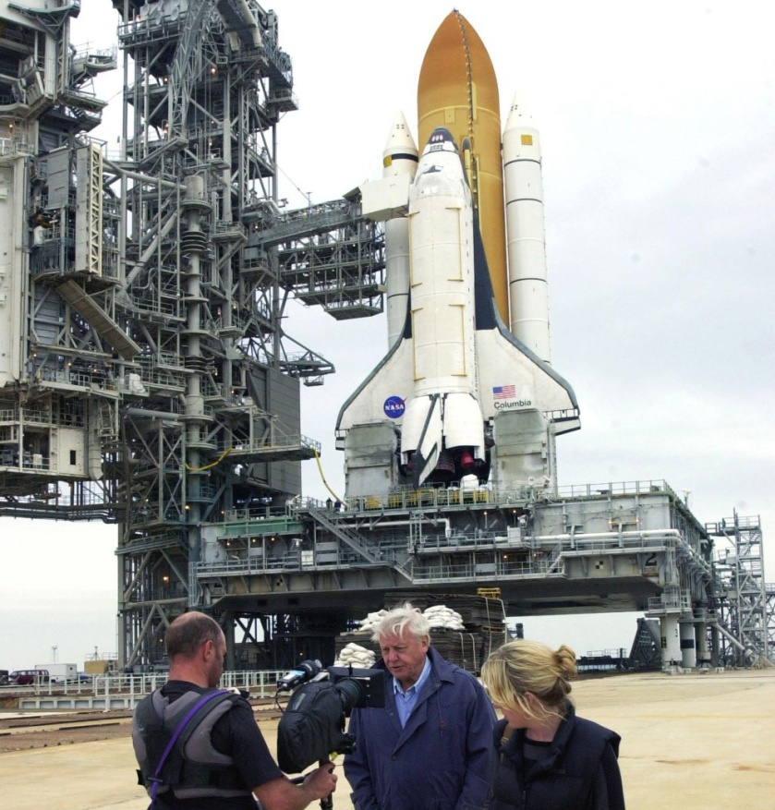
THE NEW SYSTEM
COUNCIL OF
SCIENTISTS

Slide 17
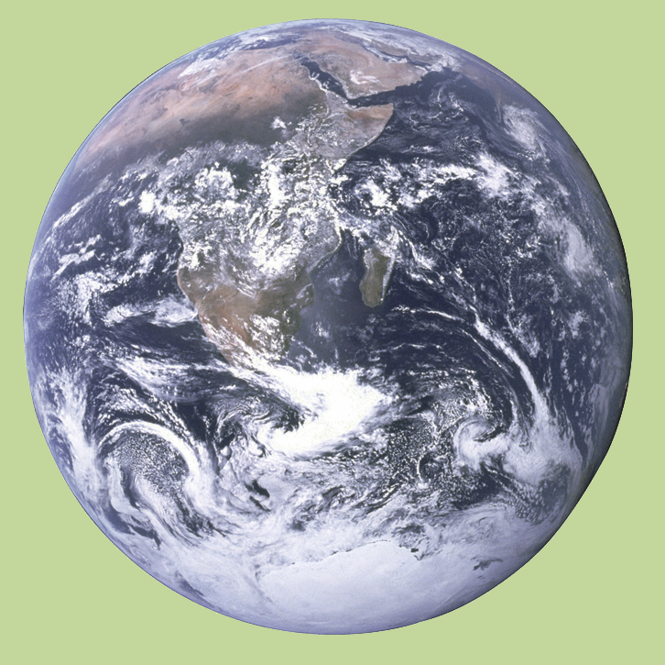
THE NEW SYSTEM
MINISTRY OF SCIENCE
ECOLOGY
SOCIOLOGY
HEALTH
ENERGY
PROPULSION
CONSTRUCTION
PHYSICS
METEOROLOGY
COMMUNICATIONS
COMPUTERS/AI
SPACE
GLOBAL DATABASE

Slide 18

THE NEW SYSTEM
MINISTRY OF INFORMATION COORDINATION AND ORDER
INFO
COMMS
EDU
LAW ENF
JUSTICE
COORD
GLOBAL
ADAPTABILITY
REGIONAL
LOCAL
CLOSENESS

Slide 19
THE NEW SYSTEM
MINISTRY OF RESOURCE MANAGEMENT
DEPARTMENT OF CONSTRUCTION AND PRODUCTION
DEPARTMENT OF LOGISTICS
DEPARTMENT OF RESOURCE MONITORING
GLOBAL
ADAPTABILITY
REGIONAL
LOCAL
CLOSENESS

Slide 20
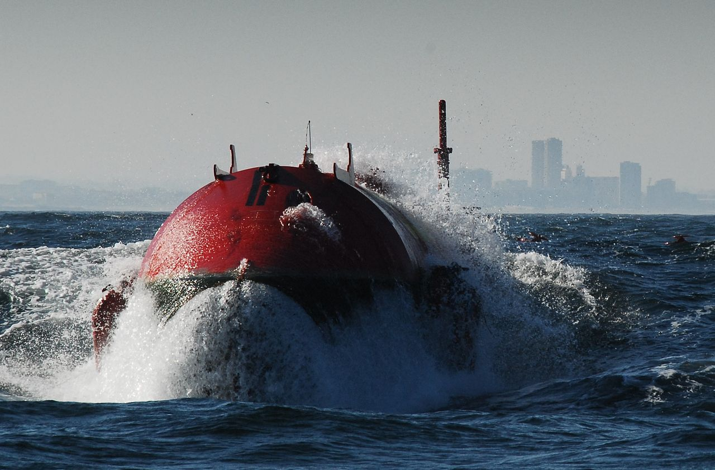
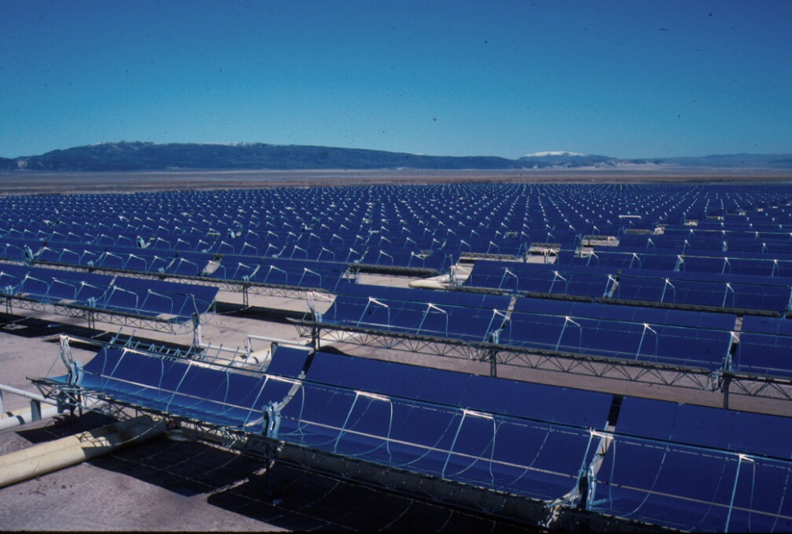
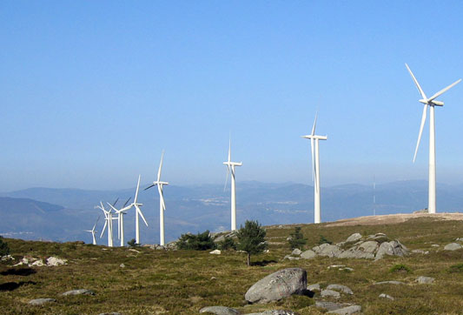
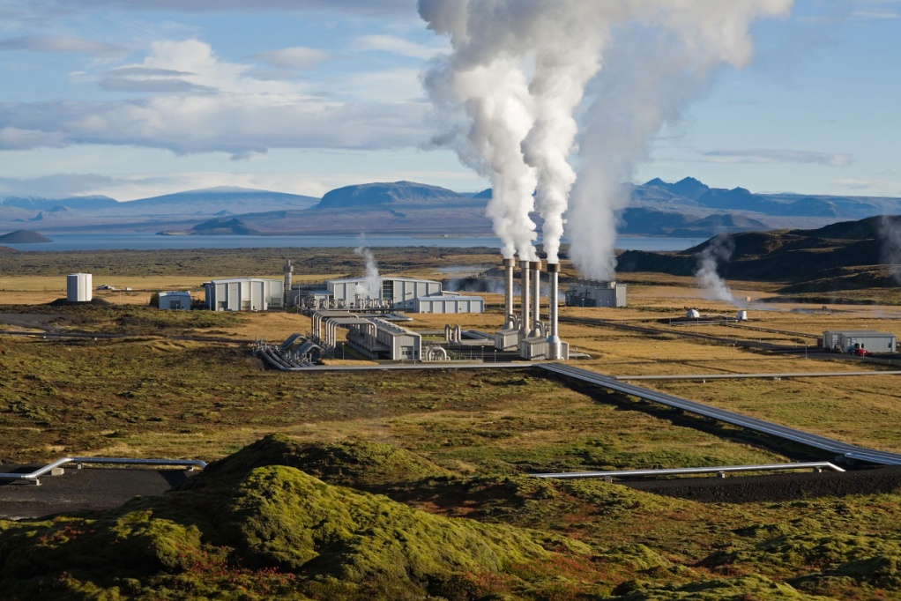
FUTURE ENRGY
>80%
4.1% desert area = 100%
AND WHAT MORE?
10x
3600x

Slide 21
HUMAN RIGHTS
HEALTH/FOOD
HOME
EDUCATION AND KNOWLEDGE
SPEECH/WRITING
BELIEF
SEXUAL ORIENTATION/BELONGING
ETHNICITY
CLOTHES
PUBLIC TRANSPORTATION

Slide 22


WORK AND REWARD
BENEFIT → REWARD
How much?
How many?
How long?

Slide 23
THE GREATER EARTH MOVEMENT
CONTACT: robin_saask@hotmail.com
FACEBOOK: The Greater Earth Movement

